Slide 1
Module 5
Automation Tool

Slide 2
Topics to be discussed
Apache Maven
Functional/BDD Testing using Selenium

Slide 3
Apache Maven: Maven Fundamentals
Maven is a powerful project management tool that is based on POM (project object model). It is used for projects build, dependency and documentation.
It simplifies the build process like ANT. But it is too much advanced than ANT.
Current version of Maven is 3.

Slide 4
Understanding the problem without Maven
There are many problems that we face during the project development. They are discussed below:
1) Adding set of Jars in each project: In case of struts, spring, hibernate frameworks, we need to add set of jar files in each project. It must include all the dependencies of jars also.
2) Creating the right project structure: We must create the right project structure in servlet, struts etc, otherwise it will not be executed.
3) Building and Deploying the project: We must have to build and deploy the project so that it may work.

Slide 5
tasks
It makes a project easy to build
It provides uniform build process (maven project can be shared by all the maven projects)
It provides project information (log document, cross referenced sources, mailing list, dependency list, unit test reports etc.)
It is easy to migrate for new features of Maven

Slide 6
Apache Maven helps to manage
Builds
Documentation
Reporing
SCMs
Releases
Distribution

Slide 7
Build Tool
Generates source code (if auto-generated code is used)
Generates documentation from source code
Compiles source code
Packages compiled code into JAR of ZIP file
Installs the packaged code in local repository, server repository, or central repository

Slide 8
Difference between Ant and Maven
Ant | Maven
Ant doesn't has formal conventions, so we need to provide information of the project structure in build.xml file. | Maven has a convention to place source code, compiled code etc. So we don't need to provide information about the project structure in pom.xml file.
Ant is procedural, you need to provide information about what to do and when to do through code. You need to provide order. | Maven is declarative, everything you define in the pom.xml file.
There is no life cycle in Ant. | There is life cycle in Maven.
It is a tool box. | It is a framework.
It is mainly a build tool. | It is mainly a project management tool.
The ant scripts are not reusable. | The maven plugins are reusable.

Slide 9
Software Setup - How to install Maven on windows
You can download and install maven on windows, linux and MAC OS platforms. Here, we are going to learn how to install maven on windows OS.
To install maven on windows, you need to perform following steps:
Download maven and extract it
Add JAVA_HOME and MAVEN_HOME in environment variable
Add maven path in environment variable
Verify Maven

Slide 10
1) Download Maven
To install maven on windows, you need to download apache maven first.
Download Maven latest Maven software from Download latest version of Maven
For example: apache-maven-3.1.1-bin.zip
Extract it. Now it will look like this:

Slide 11
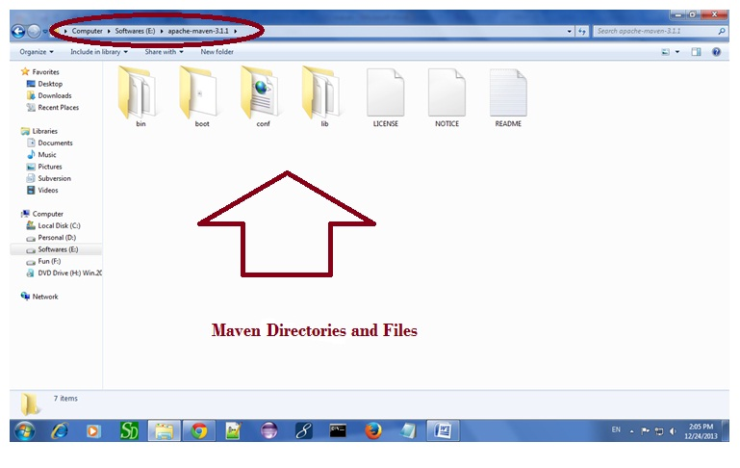
Installation procedure

Slide 12
2) Add MAVEN_HOME in environment variable
Right click on MyComputer -> properties -> Advanced System Settings -> Environment variables -> click new button
Now add MAVEN_HOME in variable name and path of maven in variable value. It must be the home directory of maven i.e. outer directory of bin. For example: E:\apache-maven-3.1.1 .It is displayed below:

Slide 13
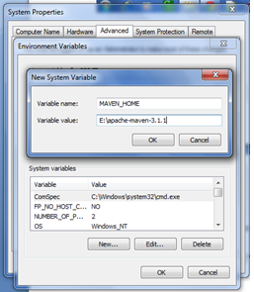
Setup
Now click on OK button.

Slide 14
3) Add Maven Path in environment variable
Click on new tab if path is not set, then set the path of maven. If it is set, edit the path and append the path of maven.
Here, we have installed JDK and its path is set by default, so we are going to append the path of maven.
The path of maven should be %maven home%/bin. For example, E:\apache-maven-3.1.1\bin

Slide 15
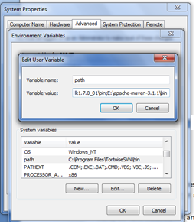
Install procedure

Slide 16
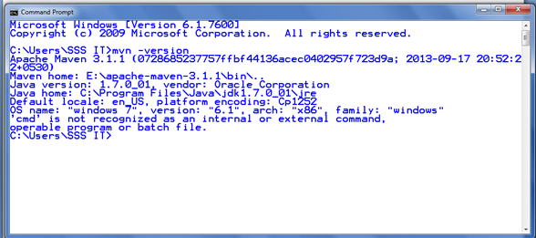
4)Verify maven
To verify whether maven is installed or not, open the command prompt and write:
mvn −version
Now it will display the version of maven and jdk including the maven home and java home.
Let's see the output:

Slide 17
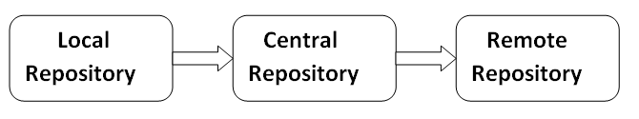
Maven Repository
A maven repository is a directory of packaged JAR file with pom.xml file. Maven searches for dependencies in the repositories. There are 3 types of maven repository:
Local Repository
Central Repository
Remote Repository
Maven searches for the dependencies in the following order:
Local repository then Central repository then Remote repository.
If dependency is not found in these repositories, maven stops processing and throws an error.

Slide 18
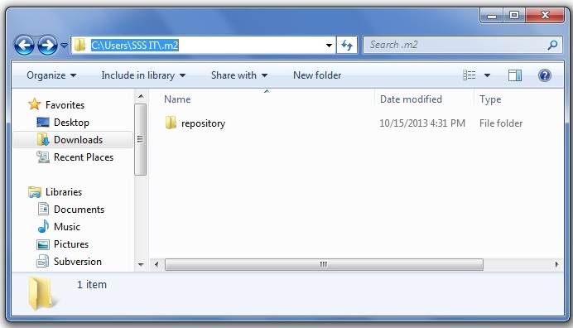
1) Maven Local Repository
Maven local repository is located in your local system. It is created by the maven when you run any maven command.
By default, maven local repository is %USER_HOME%/.m2 directory. For example: C:\Users\SSS IT\.m2.

Slide 19
Update location of Local Repository
We can change the location of maven local repository by changing the settings.xml file. It is located in MAVEN_HOME/conf/settings.xml, for example: E:\apache-maven-3.1.1\conf\settings.xml.
Let's see the default code of settings.xml file.
settings.xml
...
<settings xmlns="http://maven.apache.org/SETTINGS/1.0.0"
xmlns:xsi="http://www.w3.org/2001/XMLSchema-instance"
xsi:schemaLocation="http://maven.apache.org/SETTINGS/1.0.0 http://maven.apache.org/xsd/settings-1.0.0.xsd">
<!-- localRepository
| The path to the local repository maven will use to store artifacts.
|
| Default: ${user.home}/.m2/repository
<localRepository>/path/to/local/repo</localRepository>
-->
...
</settings>
Now change the path to local repository. After changing the path of local repository, it will look like this:
settings.xml
...
<settings xmlns="http://maven.apache.org/SETTINGS/1.0.0"
xmlns:xsi="http://www.w3.org/2001/XMLSchema-instance"
xsi:schemaLocation="http://maven.apache.org/SETTINGS/1.0.0 http://maven.apache.org/xsd/settings-1.0.0.xsd">
<localRepository>e:/mavenlocalrepository</localRepository>
...
</settings>
As you can see, now the path of local repository is e:/mavenlocalrepository.

Slide 20
2) Maven Central Repository
Maven central repository is located on the web. It has been created by the apache maven community itself.
The path of central repository is: http://repo1.maven.org/maven2/.
The central repository contains a lot of common libraries that can be viewed by this url http://search.maven.org/#browse.

Slide 21
3) Maven Remote Repository
Maven remote repository is located on the web. Most of libraries can be missing from the central repository such as JBoss library etc, so we need to define remote repository in pom.xml file.
Let's see the code to add the jUnit library in pom.xml file.
pom.xml
<project xmlns="http://maven.apache.org/POM/4.0.0"
xmlns:xsi="http://www.w3.org/2001/XMLSchema-instance"
xsi:schemaLocation="http://maven.apache.org/POM/4.0.0
http://maven.apache.org/xsd/maven-4.0.0.xsd">
<modelVersion>4.0.0</modelVersion>
<groupId>com.javatpoint.application1</groupId>
<artifactId>my-application1</artifactId>
<version>1.0</version>
<packaging>jar</packaging>
<name>Maven Quick Start Archetype</name>
<url>http://maven.apache.org</url>
<dependencies>
<dependency>
<groupId>junit</groupId>
<artifactId>junit</artifactId>
<version>4.8.2</version>
<scope>test</scope>
</dependency>
</dependencies>
</project>
You can search any repository from Maven official website mvnrepository.com.

Slide 22
Maven pom.xml file
POM is an acronym for Project Object Model. The pom.xml file contains information of project and configuration information for the maven to build the project such as dependencies, build directory, source directory, test source directory, plugin, goals etc.
Maven reads the pom.xml file, then executes the goal.
Before maven 2, it was named as project.xml file. But, since maven 2 (also in maven 3), it is renamed as pom.xml.

Slide 23
Elements of maven pom.xml file
Element | Description
project | It is the root element of pom.xml file.
modelVersion | It is the sub element of project. It specifies the modelVersion. It should be set to 4.0.0.
groupId | It is the sub element of project. It specifies the id for the project group.
artifactId | It is the sub element of project. It specifies the id for the artifact (project). An artifact is something that is either produced or used by a project. Examples of artifacts produced by Maven for a project include: JARs, source and binary distributions, and WARs.
version | It is the sub element of project. It specifies the version of the artifact under given group.

Slide 24
File: pom.xml
<project xmlns="http://maven.apache.org/POM/4.0.0"
xmlns:xsi="http://www.w3.org/2001/XMLSchema-instance"
xsi:schemaLocation="http://maven.apache.org/POM/4.0.0
http://maven.apache.org/xsd/maven-4.0.0.xsd">
<modelVersion>4.0.0</modelVersion>
<groupId>com.javatpoint.application1</groupId>
<artifactId>my-app</artifactId>
<version>1</version>
</project>

Slide 25
Maven pom.xml file with additional elements
Element | Description
packaging | defines packaging type such as jar, war etc.
name | defines name of the maven project.
url | defines url of the project.
dependencies | defines dependencies for this project.
dependency | defines a dependency. It is used inside dependencies.
scope | defines scope for this maven project. It can be compile, provided, runtime, test and system.

Slide 26
File: pom.xml
<project xmlns="http://maven.apache.org/POM/4.0.0"
xmlns:xsi="http://www.w3.org/2001/XMLSchema-instance"
xsi:schemaLocation="http://maven.apache.org/POM/4.0.0
http://maven.apache.org/xsd/maven-4.0.0.xsd">
<modelVersion>4.0.0</modelVersion>
<groupId>com.javatpoint.application1</groupId>
<artifactId>my-application1</artifactId>
<version>1.0</version>
<packaging>jar</packaging>
<name>Maven Quick Start Archetype</name>
<url>http://maven.apache.org</url>
<dependencies>
<dependency>
<groupId>junit</groupId>
<artifactId>junit</artifactId>
<version>4.8.2</version>
<scope>test</scope>
</dependency>
</dependencies>
</project>

Slide 27
Standard Directory Layout/Structure
src - main - java - resources - webapp - test - java - resources - target
src/main/java | Application/Library sources
src/main/resources | Application/Library resources
src/main/filters | Resource filter files
src/main/webapp | Web application sources
src/test/java | Test sources
src/test/resources | Test resources
src/test/filters | Test resource filter files
src/it | Integration Tests (primarily for plugins)
src/assembly | Assembly descriptors
src/site | Site
LICENSE.txt | Project's license
NOTICE.txt | Notices and attributions required by libraries that the project depends on
README.txt | Project's readme

Slide 28
Maven Webapp in Eclipse
You can import the maven web project in eclipse. To do so, perform following steps:
1) Open eclipse IDE
2) Import the maven project
File Menu -> Import -> Maven -> Existing Maven Projects

Slide 29
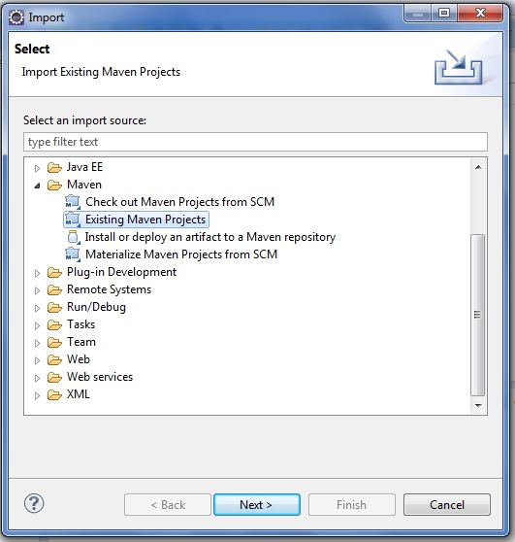

Slide 30
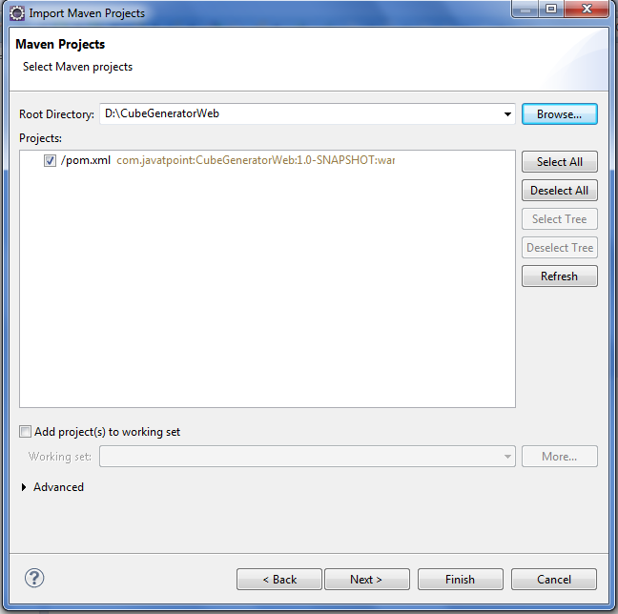
-> Next -> Browse Project

Slide 31
-> Finish.
3) Run the maven web project
Right click on project -> Run As -> Run on Server

Slide 32
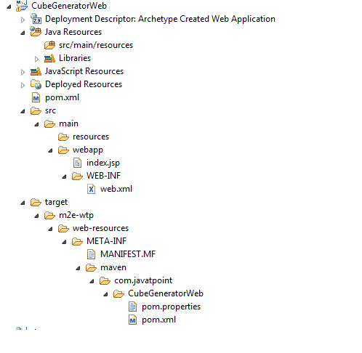
Directory Structure of Maven Webapp in Eclipse

Slide 33
Maven Plugins
The maven plugins are central part of maven framework, it is used to perform specific goal.
According to Apache Maven, there are 2 types of maven plugins.
Build Plugins
Reporting Plugins
Build Plugins
These plugins are executed at the time of build. These plugins should be declared inside the <build> element.
Reporting Plugins
These plugins are executed at the time of site generation. These plugins should be declared inside the <reporting> element.

Slide 34
Maven Core Plugins
Plugin | Description
clean | clean up after build.
compiler | compiles java source code.
deploy | deploys the artifact to the remote repository.
failsafe | runs the JUnit integration tests in an isolated classloader.
install | installs the built artifact into the local repository.
resources | copies the resources to the output directory for including in the JAR.
site | generates a site for the current project.
surefire | runs the JUnit unit tests in an isolated classloader.
verifier | verifies the existence of certain conditions. It is useful for integration tests.

Slide 35
List of Maven Plugins
To see the list of maven plugins, you may visit apache maven official website http://repo.maven.apache.org/maven2/org/apache/maven/plugins/. Maven plugins are also available outside the maven at codehaus.org and code.google.com.

Slide 36
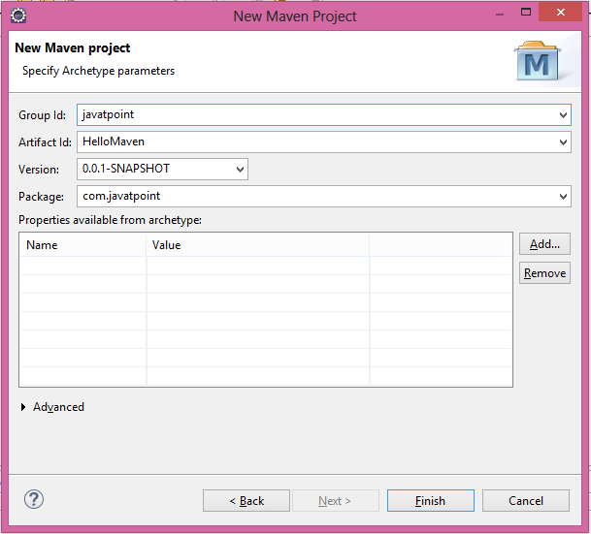
Maven Eclipse Example
Maven eclipse tutorial explains how to create maven example in eclipse.
In eclipse, click on File menu → New → Project → Maven → Maven Project. → Next → Next → Next. Now write the group Id, artifact Id, Package as shown in below figure → finish.

Slide 37
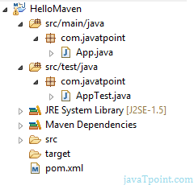
POM.xml
Now you will see a maven project with complete directory structure. All the files will be created automatically such as Hello Java file, pom.xml file, test case file etc. The directory structure of the maven project is shown in the below figure.

Slide 38
App.Java
Now you can see the code of App.java file and run it. It will be like the given code:
package com.javatpoint;
/**
* Hello world!
*
*/
public class App
{
public static void main( String[] args )
{
System.out.println( "Hello World!" );
}
}

Slide 39
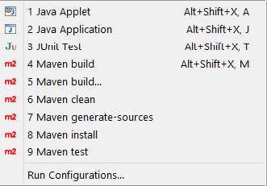
Output
If you right click on the project → Run As, you will see the maven options to build the project.

Slide 40
Maven's Multi-Module Project
A multi-module project is built from an aggregator POM that manages a group of submodules. In most cases, the aggregator is located in the project's root directory and must have packaging of type pom.
The submodules are regular Maven projects, and they can be built separately or through the aggregator POM.
By building the project through the aggregator POM, each project that has a packaging type different from pom will result in a built archive file.

Slide 41
Benefits of Using Multi-Modules
reduce duplication.
build our application's modules in a single command
share a vast amount of configuration with other modules.

Slide 42
Parent POM
Maven supports inheritance in a way that each pom.xml file has the implicit parent POM. It's called Super POM and can be located in the Maven binaries. These two files are merged by Maven and form the Effective POM.
We can create our own pom.xml file, which will serve us as the parent project. Then we can include in it all configuration with dependencies, and set it as the parent of our child modules, so they'll inherit from it.
Besides the inheritance, Maven provides the notion of aggregation. A parent POM that leverages this functionality is called an aggregate POM. Basically, this kind of POM declares its modules explicitly in its pom.xml file.

Slide 43
Submodules
Submodules, or subprojects, are regular Maven projects that inherit from the parent POM. As we already know, inheritance lets us share the configuration and dependencies with submodules. However, if we'd like to build or release our project in one shot, we have to declare our submodules explicitly in the parent POM. Ultimately, our parent POM will be the parent, as well as the aggregate POM.

Slide 44
Creating Maven multi-module project with Eclipse
http://websystique.com/maven/creating-maven-multi-module-project-with-eclipse/

Slide 45
Selenium
Selenium is one of the most widely used open source Web UI (User Interface) automation testing suite.It was originally developed by Jason Huggins in 2004 as an internal tool at Thought Works. Selenium supports automation across different browsers, platforms and programming languages.
Selenium can be easily deployed on platforms such as Windows, Linux, Solaris and Macintosh. Moreover, it supports OS (Operating System) for mobile applications like iOS, windows mobile and android.
Selenium supports a variety of programming languages through the use of drivers specific to each language.Languages supported by Selenium include C#, Java, Perl, PHP, Python and Ruby.Currently, Selenium Web driver is most popular with Java and C#. Selenium test scripts can be coded in any of the supported programming languages and can be run directly in most modern web browsers. Browsers supported by Selenium include Internet Explorer, Mozilla Firefox, Google Chrome and Safari.
Selenium can be used to automate functional tests and can be integrated with automation test tools such as Maven, Jenkins, & Docker to achieve continuous testing. It can also be integrated with tools such as TestNG, & JUnit for managing test cases and generating reports.

Slide 46
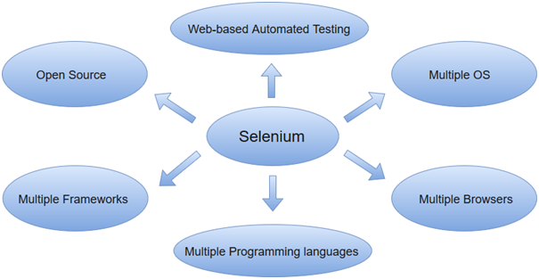

Slide 47
Automation Testing
Automation testing uses the specialized tools to automate the execution of manually designed test cases without any human intervention. Automation testing tools can access the test data, controls the execution of tests and compares the actual result against the expected result. Consequently, generating detailed test reports of the system under test.
Automation testing covers both functional and performance test on an application.
Functional automation is used for automation of functional test cases. For example, regression tests, which are repetitive in nature, are automated.
Performance automation is used for automation of non-functional performance test cases. For example, measuring the response time of the application under considerable (say 100 users) load.
Automation Testing tools which are used for functional automation:
Quick Test Professional, provided by HP.
Rational Robot, provided by IBM.
Coded UI, provided by Microsoft.
Selenium, open source.
Auto It, open Source.
Automation Testing tools which are used for non-functional automation:
Load Runner, provided by HP.
JMeter, provided by Apache.
Burp Suite, provided by PortSwigger.
Acunetix, provided by Acunetix.

Slide 48
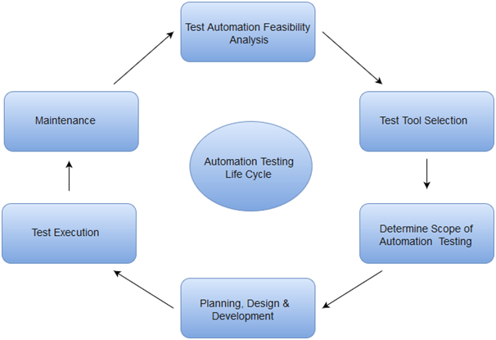
Automation Testing Life Cycle

Slide 49
benefits of test automation
Automated testing has long been considered beneficial for big software organizations. Although, it is often thought to be too expensive or difficult for smaller companies to implement.
Automated testing tools can be programmed to build and execute test scripts at a specific time without involving any human intervention.For instance, automated test can be automatically kicked off overnight, and the testers can analyse the results of the automated the next morning.
Automated testing tools are able to playback pre-recorded and pre-defined actions.
Automation testing supports frequent regression testing.
It provides rapid feedback to developers.
It provides unlimited iterations of test case execution.
It provides disciplined documentation of test cases.
Automated test generates customized defect reports.
Less error prone as compared to manual testing.

Slide 50
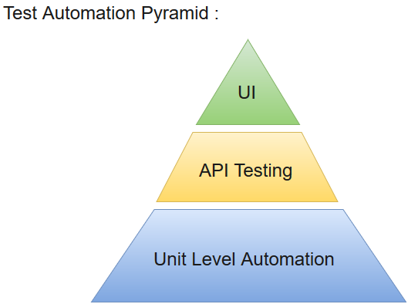
AutomatedTest

Slide 51
Selenium Features
Selenium is an open source and portable Web testing Framework.
Selenium IDE provides a playback and record feature for authoring tests without the need to learn a test scripting language.
It can be considered as the leading cloud-based testing platform which helps testers to record their actions and export them as a reusable script with a simple-to-understand and easy-to-use interface.
Selenium supports various operating systems, browsers and programming languages. Following is the list:
Programming Languages: C#, Java, Python, PHP, Ruby, Perl, and JavaScript
Operating Systems: Android, iOS, Windows, Linux, Mac, Solaris.
Browsers: Google Chrome, Mozilla Firefox, Internet Explorer, Edge, Opera, Safari, etc.
It also supports parallel test execution which reduces time and increases the efficiency of tests.
Selenium can be integrated with frameworks like Ant and Maven for source code compilation.
Selenium can also be integrated with testing frameworks like TestNG for application testing and generating reports.
Selenium requires fewer resources as compared to other automation test tools.
WebDriver API has been indulged in selenium whichis one of the most important modifications done to selenium.
Selenium web driver does not require server installation, test scripts interact directly with the browser.
Selenium commands are categorized in terms of different classes which make it easier to understand and implement.
Selenium Remote Control (RC) in conjunction with WebDriver API is known as Selenium 2.0. This version was built to support the vibrant web pages and Ajax.

Slide 52
Selenium Limitations
Selenium does not support automation testing for desktop applications.
Selenium requires high skill sets in order to automate tests more effectively.
Since Selenium is open source software, you have to rely on community forums to get your technical issues resolved.
We can't perform automation tests on web services like SOAP or REST using Selenium.
We should know at least one of the supported programming languages to create tests scripts in Selenium WebDriver.
It does not have built-in Object Repository like UTF/QTP to maintain objects/elements in centralized location. However, we can overcome this limitation using Page Object Model.
Selenium does not have any inbuilt reportingcapability; you have to rely on plug-ins like JUnit and TestNG for test reports.
It is not possible to perform testing on images. We need to integrate Selenium with Sikuli for image based testing.
Creating test environment in Selenium takes more time as compared to vendor tools like UFT, RFT, Silk test, etc.
No one is responsible for new features usage; they may or may not work properly.
Selenium does not provide any test tool integration for Test Management.

Slide 53
Selenium Tool Suite
Selenium is not just a single tool but a suite of software, each with a different approach to support automation testing. It comprises of four major components which include:
Selenium Integrated Development Environment (IDE)
Selenium Remote Control (Now Deprecated)
WebDriver
Selenium Grid

Slide 54
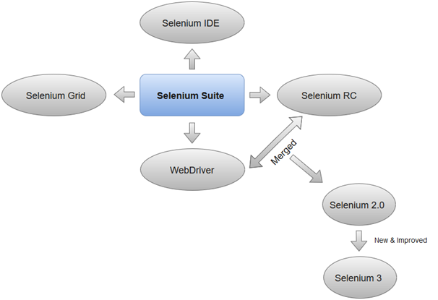

Slide 55
1.Selenium Integrated Development Environment (IDE)
Selenium IDE is implemented as Firefox extension which provides record and playback functionality on test scripts. It allows testers to export recorded scripts in many languages like HTML, Java, Ruby, RSpec, Python, C#, JUnit and TestNG. You can use these exported script in Selenium RC or Webdriver.
>Selenium IDE has limited scope and the generated test scripts are not very robust and portable.

Slide 56
2. Selenium Remote Control
Selenium RC (officially deprecated by selenium)allows testers to write automated web application UI test in any of the supported programming languages. It also involves an HTTP proxy server which enables the browser to believe that the web application being tested comes from the domain provided by proxy server.
Selenium RC comes with two components.
Selenium RC Server (acts as a HTTP proxy for web requests).
>Selenium RC Client (library containing your programming language code).

Slide 57
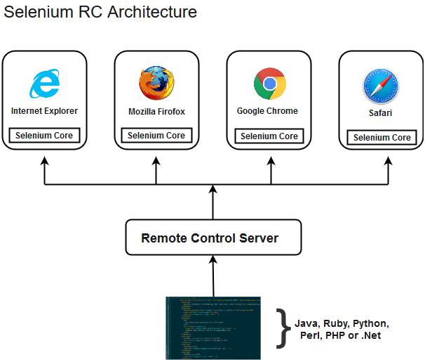
Architecture
The figure given below shows the architectural representation of Selenium RC.

Slide 58
3. Selenium WebDriver
Selenium WebDriver (Selenium 2) is the successor to Selenium RC and is by far the most important component of Selenium Suite. SeleniumWebDriverprovides a programming interface to create and execute test cases. Test scripts are written in order to identify web elements on web pages and then desired actions are performed on those elements.
Selenium WebDriver performs much faster as compared to Selenium RC because it makes direct calls to the web browsers. RC on the other hand needs an RC server to interact with the web browser.
Since, WebDriver directly calls the methods of different browsers hence we have separate driver for each browser. Some of the most widely used web drivers include:
Mozilla Firefox Driver (Gecko Driver)
Google Chrome Driver
Internet Explorer Driver
Opera Driver
Safari Driver
HTML Unit Driver (a special headless driver)

Slide 59
4. Selenium Grid
Selenium Grid is also an important component of Selenium Suite which allows us to run our tests on different machines against different browsers in parallel. In simple words, we can run our tests simultaneously on different machines running different browsers and operating systems.
Selenium Grid follows the Hub-Node Architecture to achieve parallel execution of test scripts. The Hub is considered as master of the network and the other will be the nodes. Hub controls the execution of test scripts on various nodes of the network.

Slide 60
Selenium Integrated Development Environment (IDE)
Selenium IDE (Integrated Development Environment) is an open source web automation testing tool under the Selenium Suite. Unlike Selenium WebDriver and RC, it does not require any programming logic to write its test scripts rather you can simply record your interactions with the browser to create test cases. Subsequently, you can use the playback option to re-run the test cases.
Perhaps, creating test cases on Selenium IDE does not require any programming language but when you get to use selenese commands like runScript, a little knowledge prior to JavaScript would prove beneficial for you to understand the concepts more clearly. You can also refer our JavaScript tutorial provided under the URL:
https://www.javatpoint.com/javascript-tutorial
Note: Selenium IDE is available only as Mozilla Firefox and Chrome plug-in, which means you can't record your test cases on browsers other than Firefox and Chrome. The recorded test scripts can also be exported to programming languages like C#, Java, Ruby or Python.

Slide 61
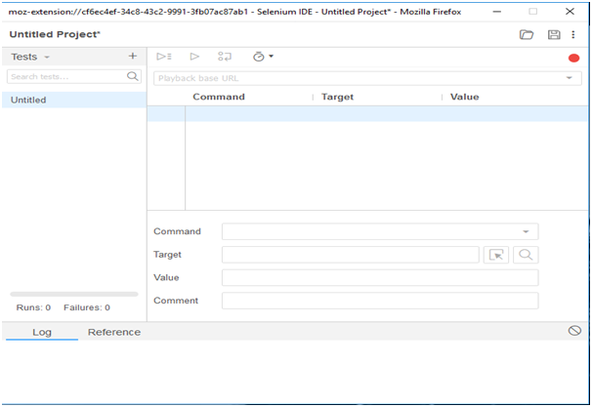
Selenium IDE

Slide 62
Selenium IDE Download and Install
Launch Mozilla Firefox browser.
Open URLhttps://addons.mozilla.org/en-us/firefox/addon/selenium-ide/It will redirect you to the official add-on page of Firefox.
Click on "Add to Firefox" button.

Slide 63
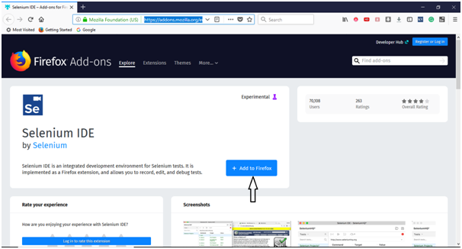

Slide 64
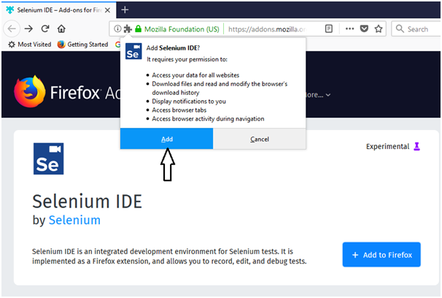
A pop-up dialog box will be appeared asking you to add Selenium IDE as extension to your Firefox browser.
Click on "Add" button.

Slide 65
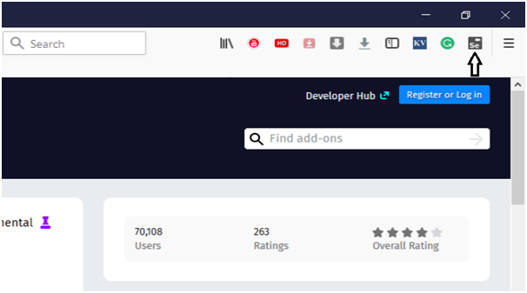
Restart you Firefox browser.
Go to the top right corner on your Firefox browser and look for the Selenium IDE icon.

Slide 66
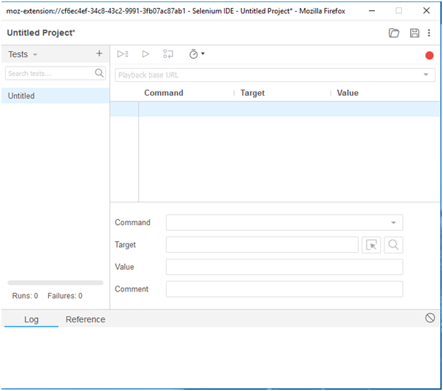
lick on that icon to launch Selenium IDE.

Slide 67
References
https://www.javatpoint.com/selenium-ide-features
https://www.javatpoint.com/selenium-ide-first-test-case
https://www.javatpoint.com/selenium-ide-login-test
https://www.javatpoint.com/selenium-ide-commands

